Slide 1
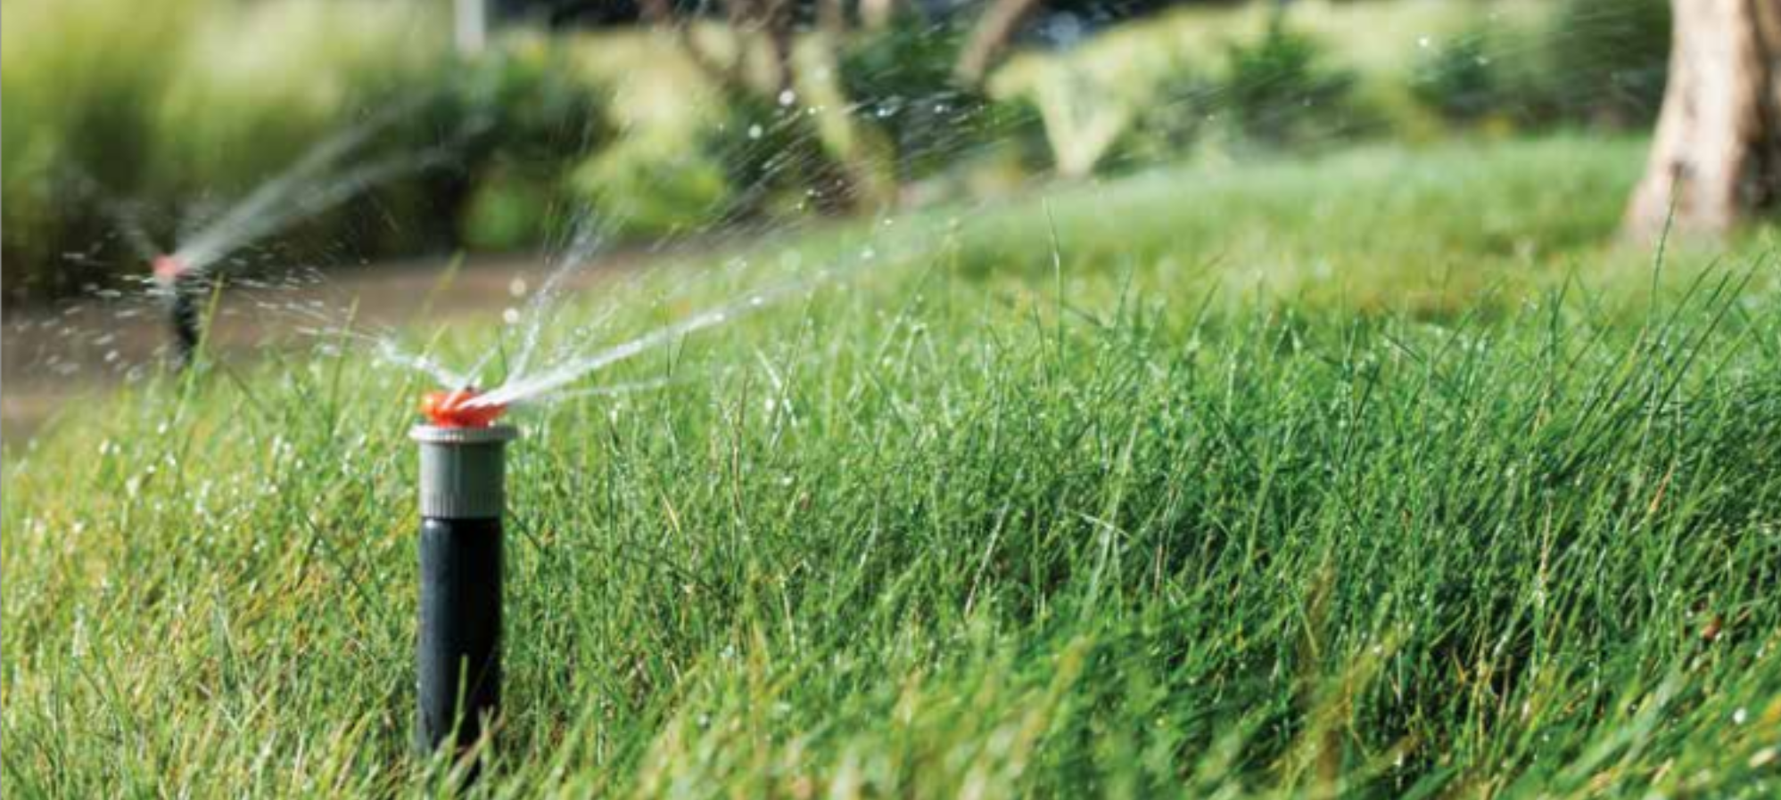
High Efficiency Irrigation Systems

Slide 2

Hunter Online Resources
Run Time Calculator
Water Savings Calculator
Training
Product Support
Freesprinklernozzle.com
Get Hunter

Slide 3
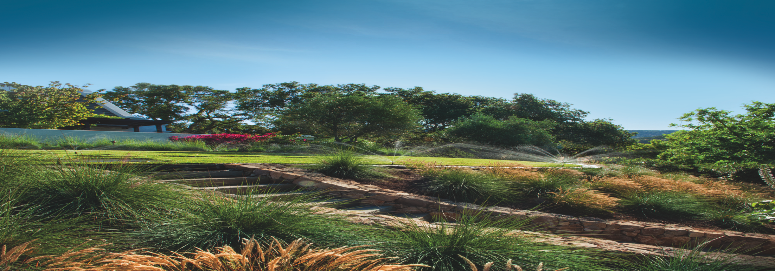
Slow the Flow
Residential Water Savings

Slide 4
Residential Water Savings Solutions
Slow the Flow = Apply water at a rate that soil can absorb it
using high efficiency irrigation equipment
  Retrofit sprays to multi-stream rotating nozzles
  Convert to drip irrigation in narrow or sparsely planted areas
  Install a pressure regulator to control the output of your system
  Install a Smart Controller or Soil Moisture Sensor

Slide 5
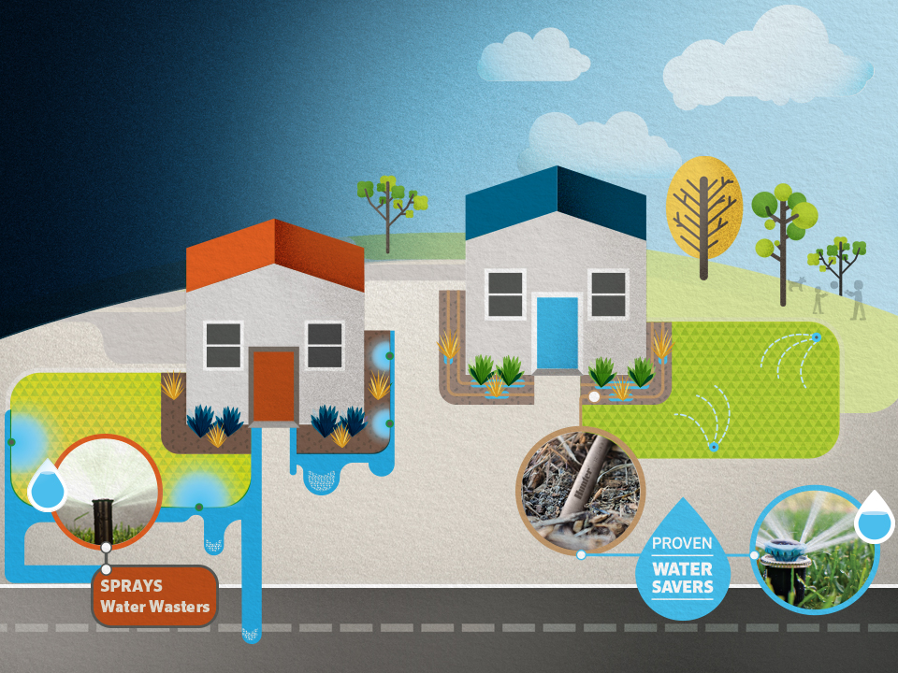
A few simple changes can dramatically
reduce outdoor water use and achieve the mandatory water use reduction in California.

Slide 6
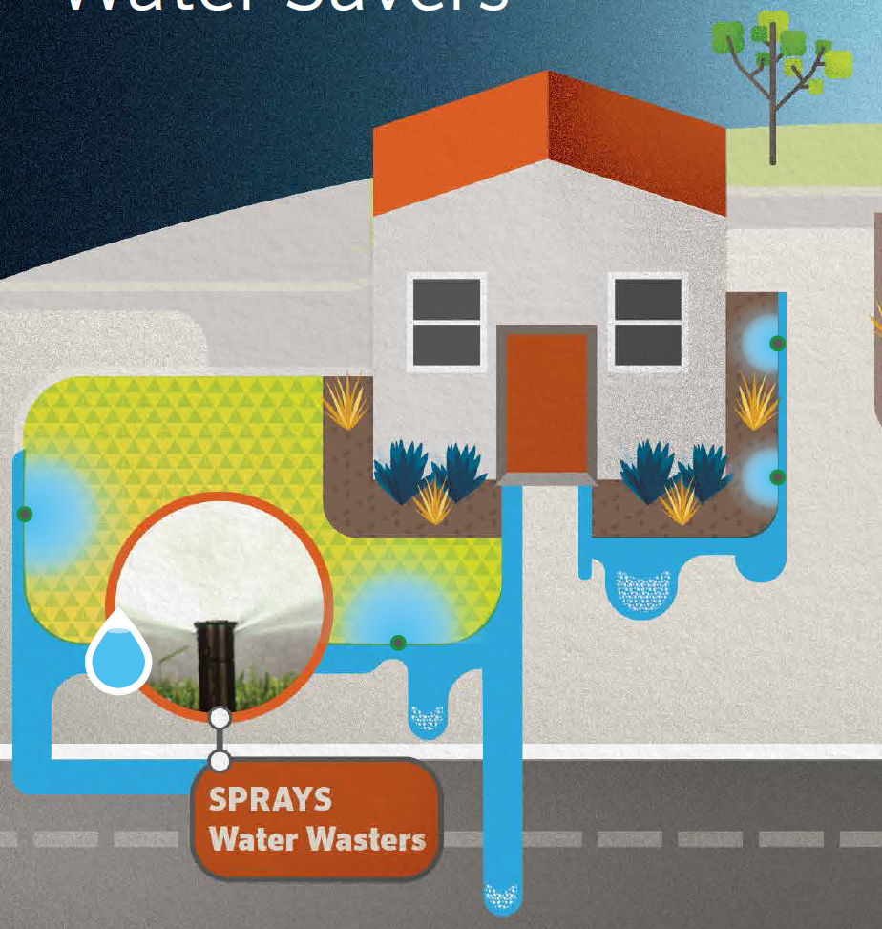
Conventional
Sprays
Subject to misting from winds
Uneven coverage
Create overspray onto hardscape
Apply water at a rate that many soils cannot absorb, creating runoff and water waste

Slide 7
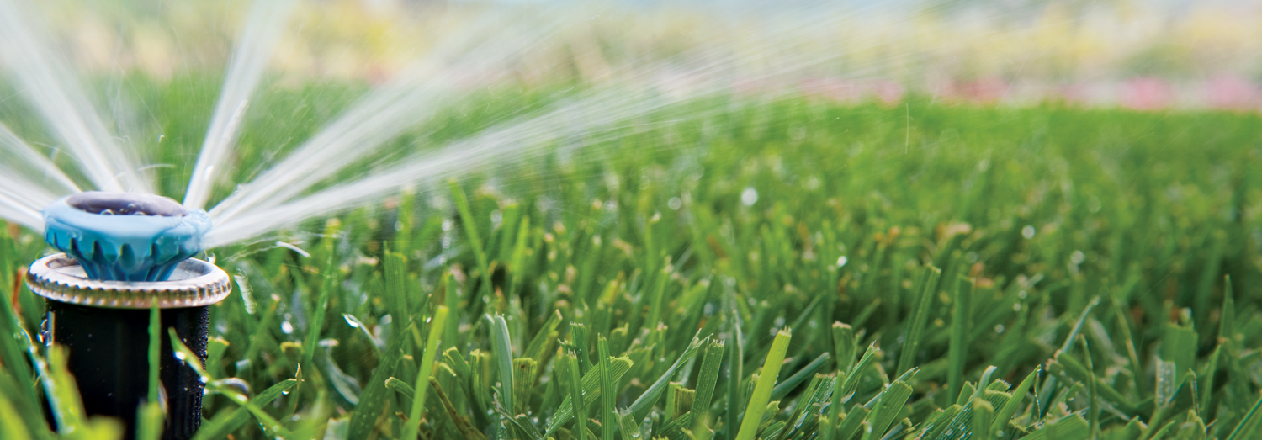
Replace Inefficient
Sprays with MP Rotators
Up to 30% Water Savings
This very simple fix allows you to keep existing turf areas and landscaping.
The MP Rotator applies multiple streams of water slowly and evenly, mimicking natural rainfall that gently soaks into the soil without runoff
or misting.
Notes:
Retrofit Sprays to MP Rotator
• Delivers multiple streams of water at a steady rate
• Slower application rate allows water to gently soak into the soil
• Increased efficiency results in 30% less water use when compared to traditional sprays - significantly reduces wasteful runoff
• Compatible with any conventional spray head body
• MPs typically require longer run times than sprays, while still saving water

Slide 8
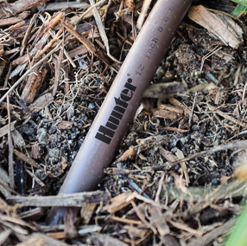
Convert Areas to Drip Irrigation
Up to 70% Water
Savings
Drip irrigation provides slow, even watering for close-in coverage right where it’s needed with no overspray
onto the hardscape.
Notes:
Small Spaces Converted to Inline Drip
• Saves 70% Water Compared to Sprays
• Install drip irrigation to slowly apply moisture to a plants root zone
• Eliminate overspray and run-off
• Drip Installed under a layer of mulch reduces evaporation
• Drip typically requires longer runtimes

Slide 9
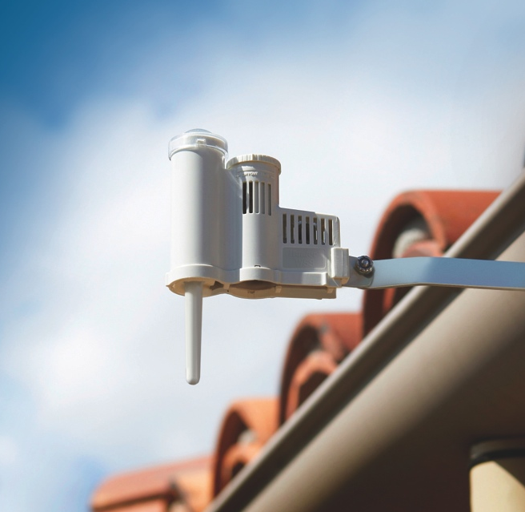
Add Smart Control
Up to 30% Water Savings
Add Solar Sync to a Hunter irrigation controller and let the controller adjust to on-site weather conditions for optimal water scheduling.
Use Hunter’s free run time calculator to generate a customized watering schedule
to prevent water waste at
http://hunter.direct/runtime
Notes:
Smart Controller
Solar Sync
• Pair with Hunter irrigation controllers
• Adjusts watering to on-site weather conditions
• Typically saves up to 30% water
• Use the online run time calculator to save even more

Slide 10
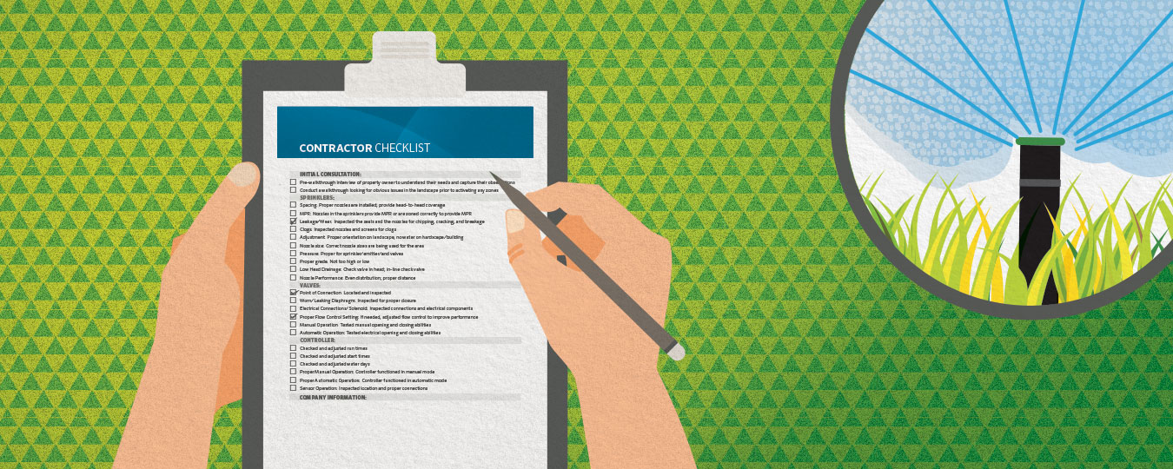
Check the System
Call a pro to inspect your irrigation system for leaks, clogs,
and wear that are silently wasting gallons of water. At a minimum, adjust sprinkler nozzles to eliminate overspray onto hardscapes.

Slide 11
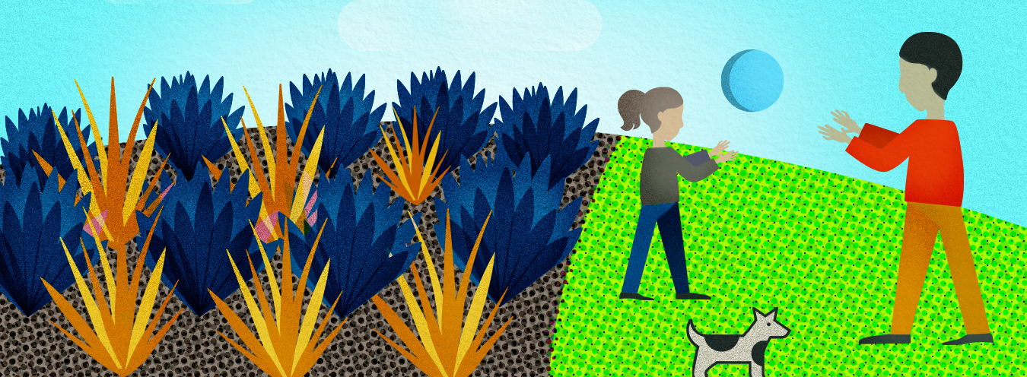
Plant Responsibly
Be selective with turf areas. Keep turf only where it’s practical and use a variety that’s regionally appropriate. Replace thirsty plants with native and drought-tolerant plants. Remember to add mulch to reduce evaporation and moderate soil temperature.

Slide 12
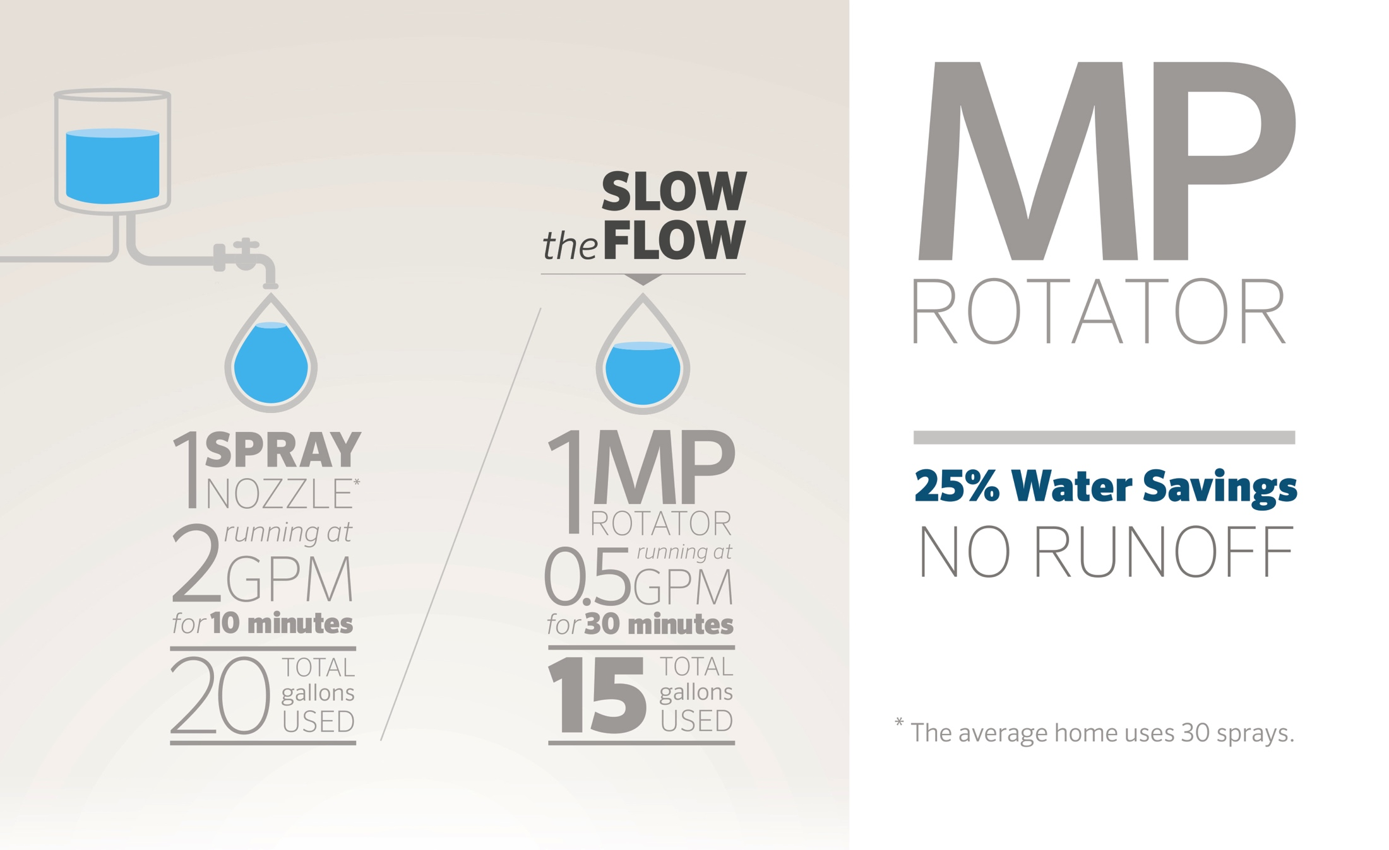

Slide 13
Landscape Maintenance
  Install mulch in planter areas
Mow turf at higher settings
Control the amount

Slide 14
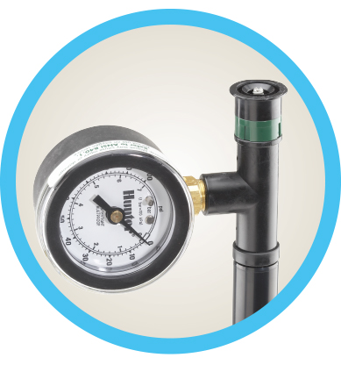
Pressure Regulation
  Your sprinkler system should never need more than 60 PSI.
  Optimal pressure for different sprinkler types:
    Drip System: 20-50 PSI
    Sprays: 30 PSI
    MP Rotators: 40 PSI
    Rotors: 50 PSI
PSI: Pounds Per Square Inch

Slide 15
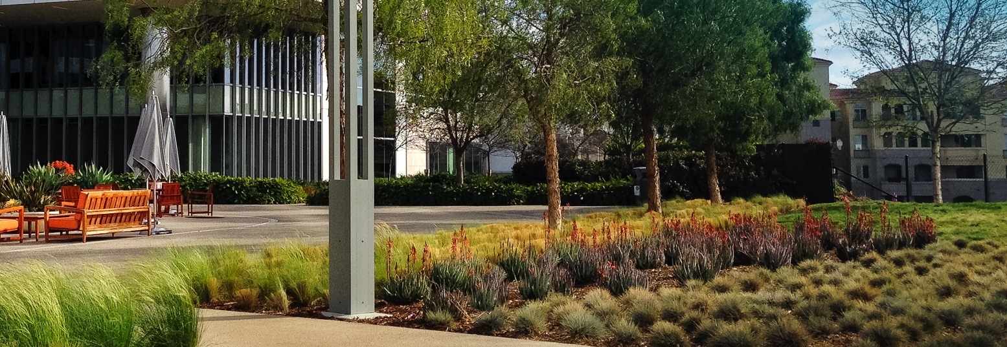
Commercial Landscape Retrofit

Slide 16
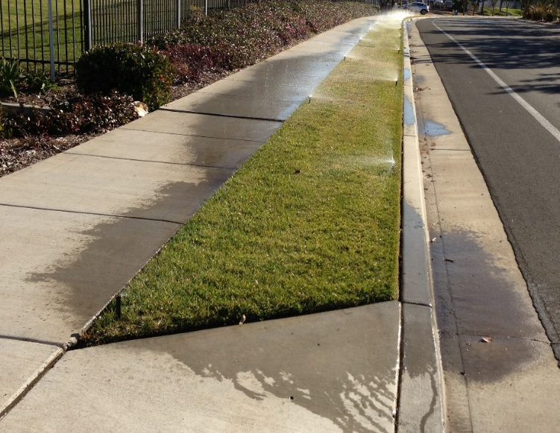
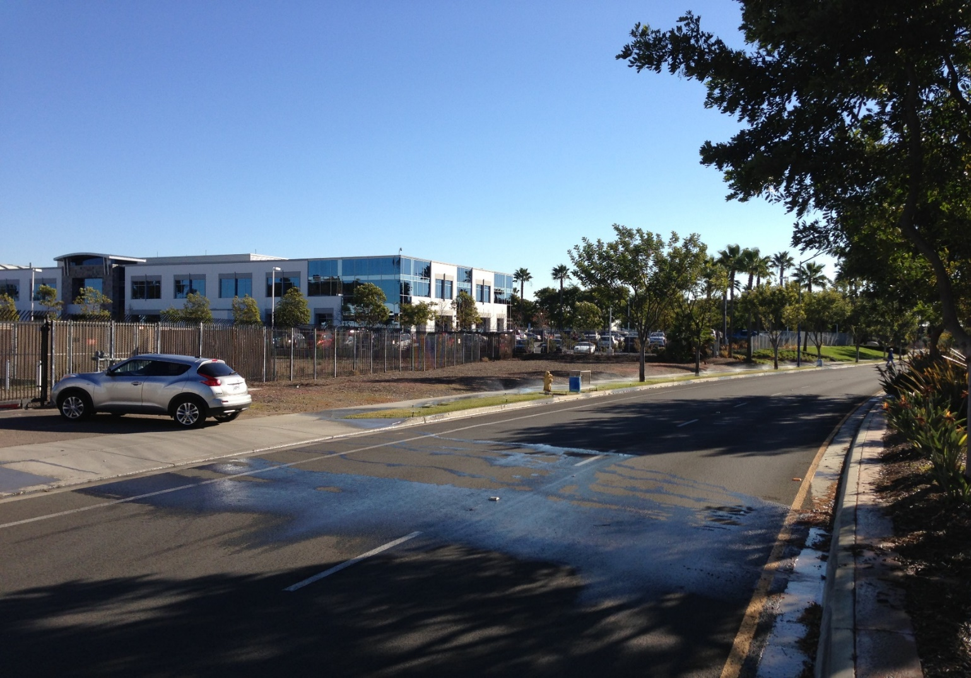
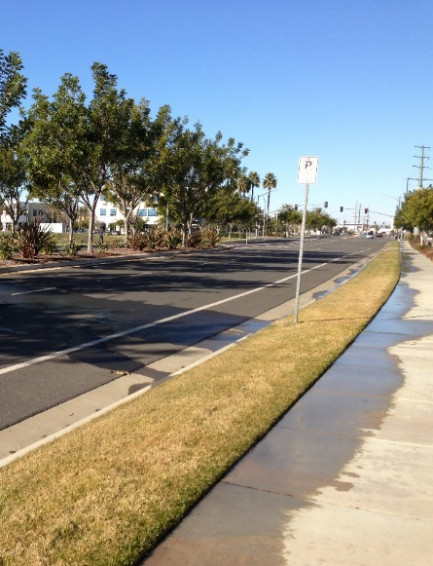
Overspray and
Run-off Are No Longer Socially Acceptable

Slide 17
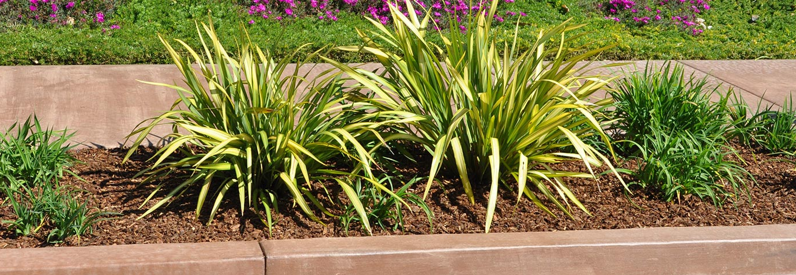
On Grade Drip

Slide 18
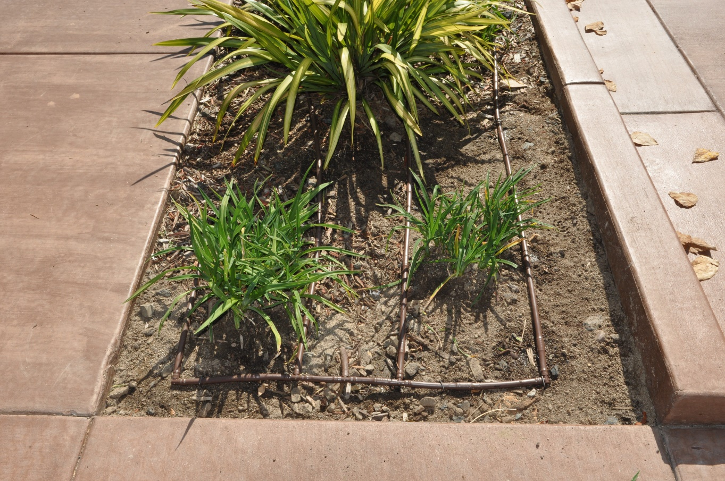
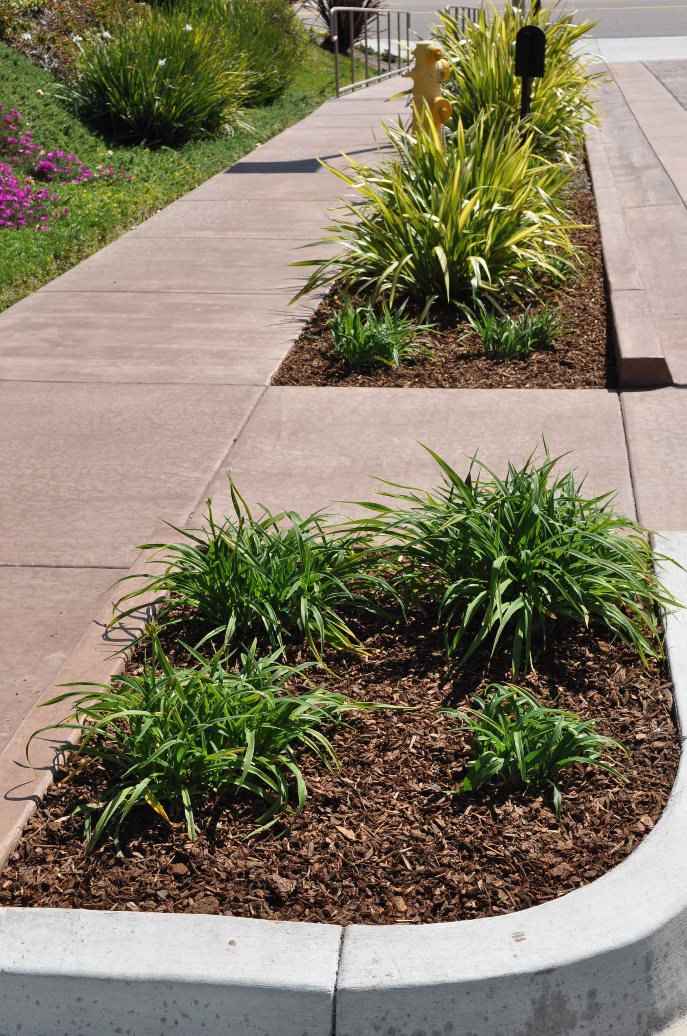
In-Line On-Grade
Drip Installation

Slide 19
On Grade Drip
Benefits:
  Easy to install
  Inexpensive to install
  Easy to repair
  Delivers water directly to roots
  No overspray
  Slower delivery of water
Issues:
  Requires more maintenance
  Difficult to schedule
  Can’s see it running / inspection
  Long term sustainability
  Damage from wildlife
  Requires Fertigation

Slide 20
Multi-Stream Rotating Nozzles
MP Rotator

Slide 21
MP ROTATOR
MP Product Line

Slide 22
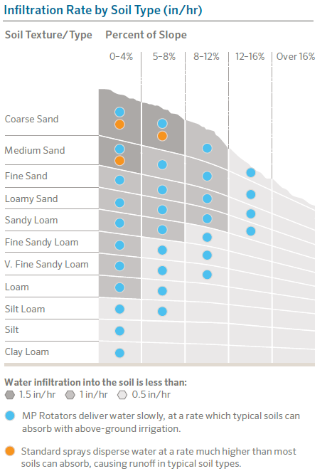
Precipitation vs. Intake Rates
MP Rotators deliver water at a slower rate that soils can absorb
Soil infiltration rates vary from 0.1–1.5 in/hr
Precipitation rates:
  Sprays average 1.5 in/hr
  MP Rotator 0.4 in/hr
  MP Rotator SR series 0.8 in/hr

Slide 23
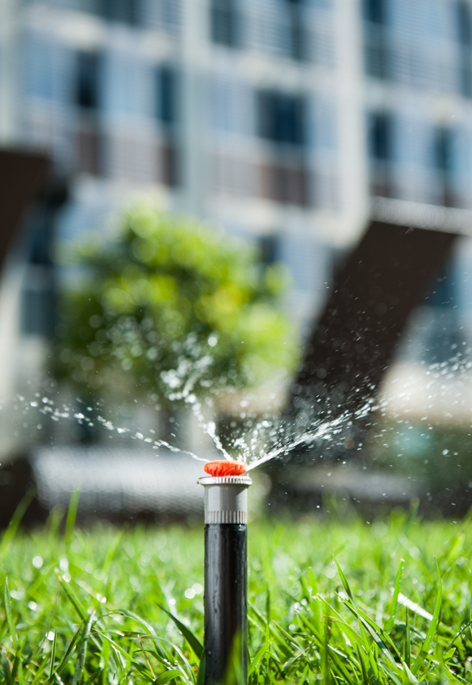
MP 800SR
(Short Radius)
Highest efficiency overhead irrigation
6’–12’ spacing
Low precipitation rate
.8” Per /hr (lowest in industry)
Ideal for high traffic areas
Riser or popup installation
Robust design
Double-pop flush
Debris resistant
Gray canister indicates SR Series

Slide 24
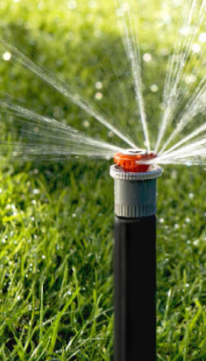
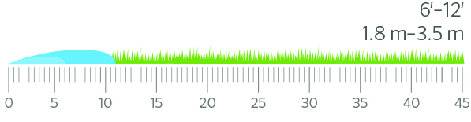
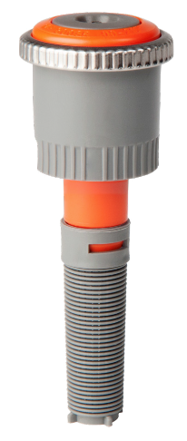
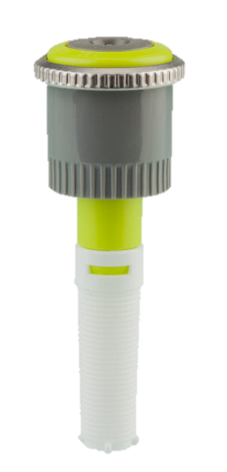
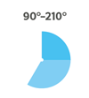
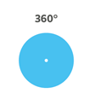
New MP800SR Series
The first high efficiency rotary nozzle to cover as narrow as 6 ft.
Low precipitation rate
of 0.8 in/hr

Slide 25
MP800 SR Series Advantages
Half the runtime of traditional MP Rotators
Less than half the flow / precip rate of conventional spray nozzles
Reduces overall water window
Maintains matched precipitation rate as arc is adjusted
Repairs underperforming spray zones

Slide 26
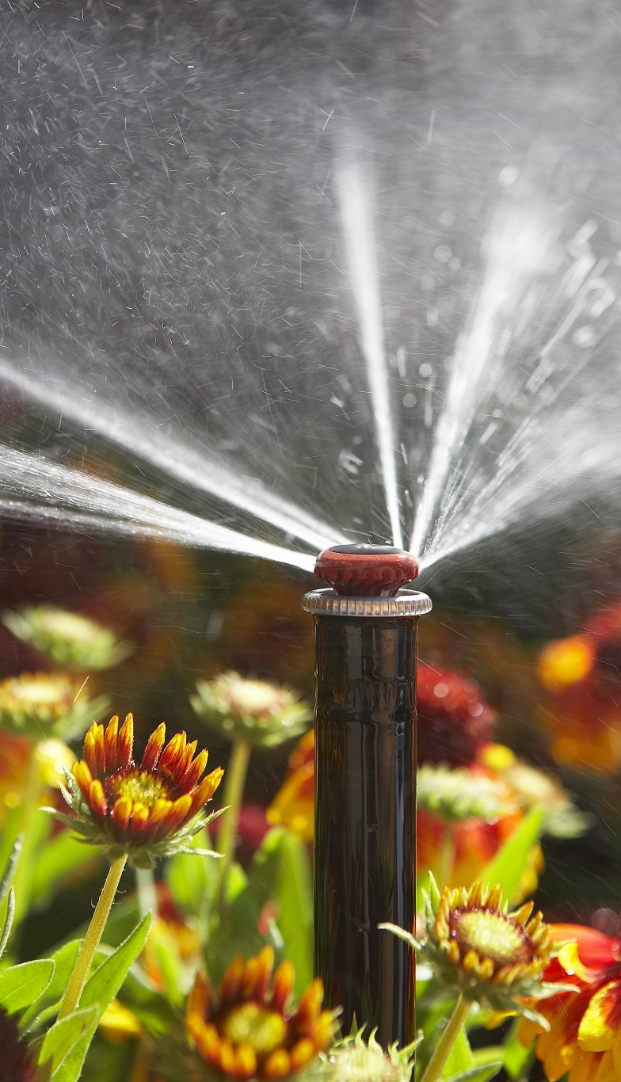
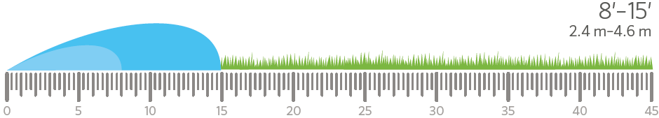
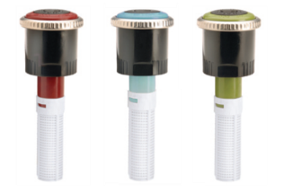
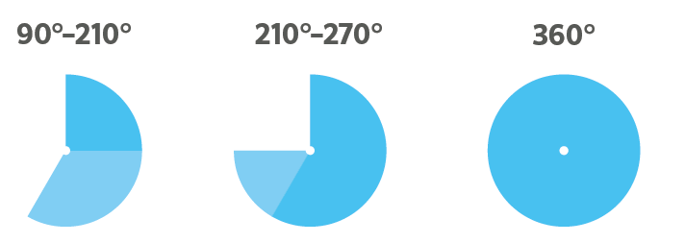
MP 1000
Stream Height at 30 PSI = 16”
2 bar = 0.4m

Slide 27
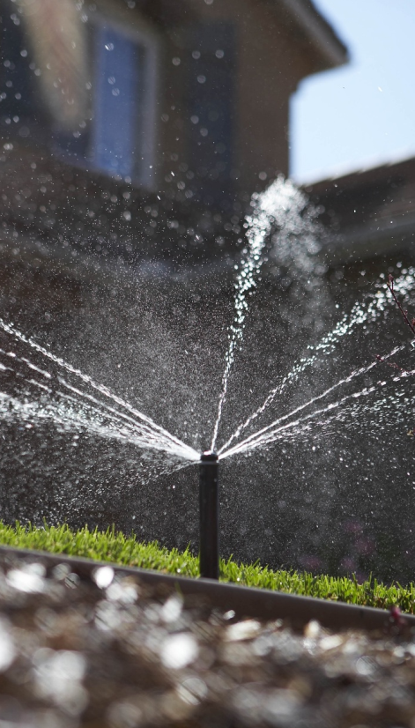
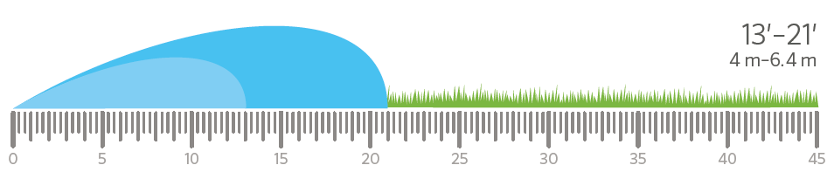
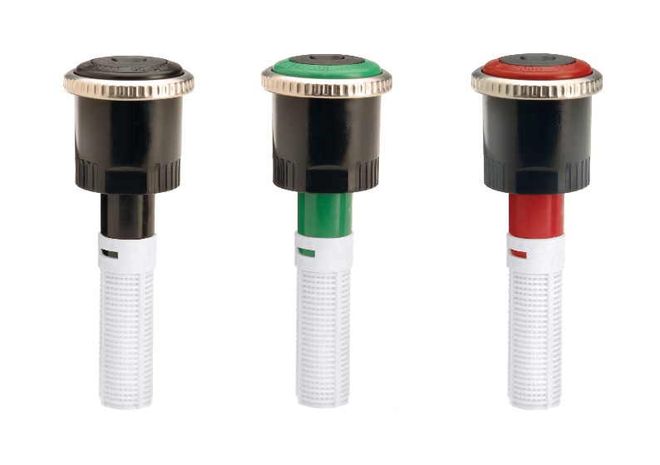
MP 2000
Stream Height at 30 PSI = 40”
2 bar = 1m

Slide 28
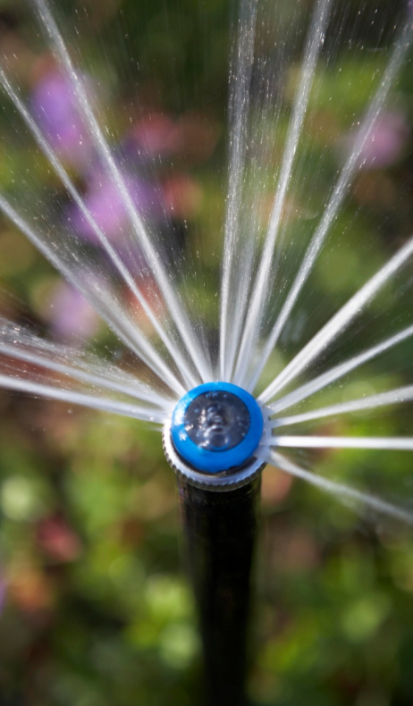
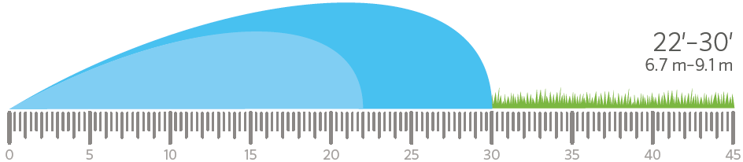
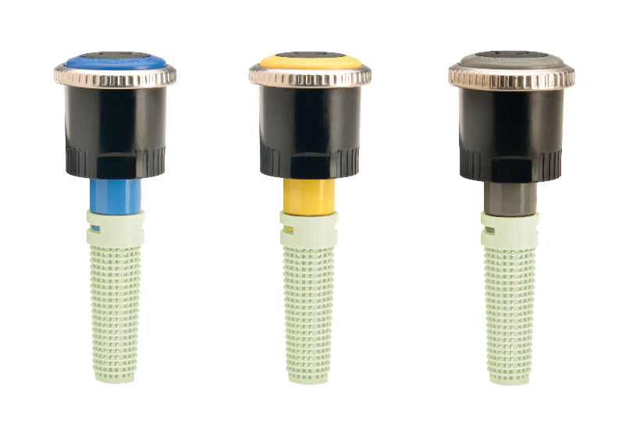
MP 3000
Stream Height at 30 PSI = 79”
2 bar = 2m

Slide 29
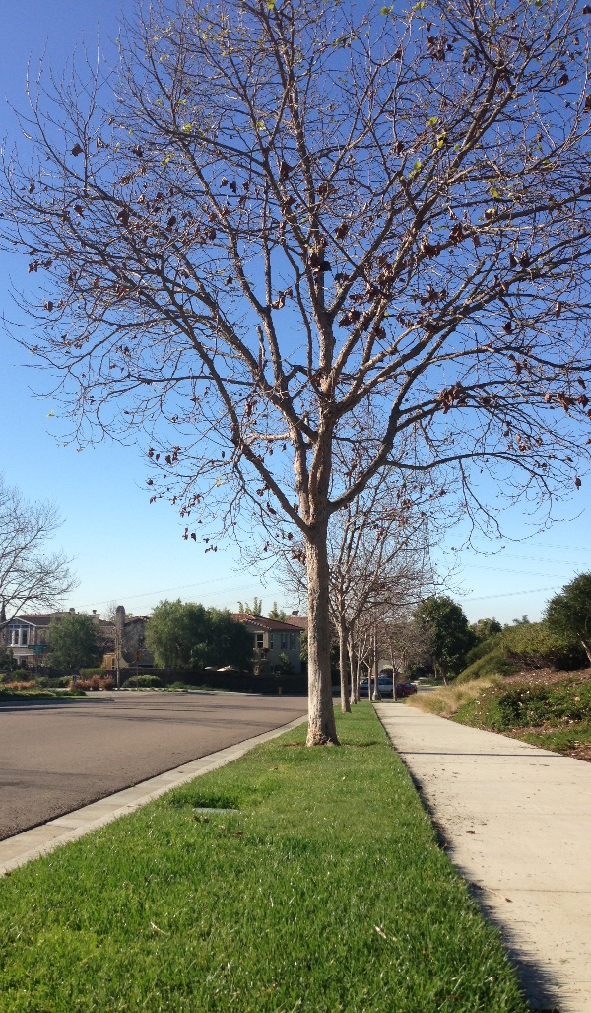
MP Side Strip
5’ x 15’ at 40 PSI
Maximum radius reduction at 30 PSI
Ideal for narrow spaces
Adjustable edges
Conforms to curves
Eliminates runoff
Minimizes overspray

Slide 30
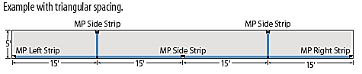

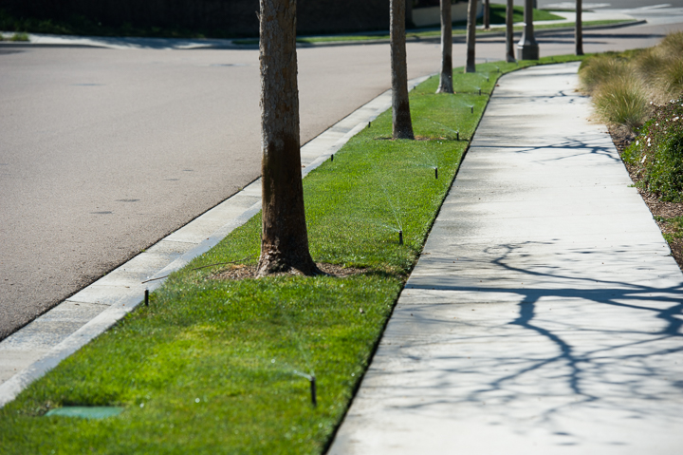
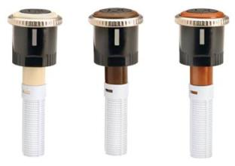


MP Strip
1.5 m

Slide 31
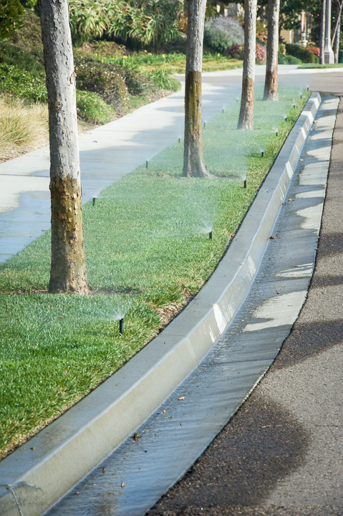
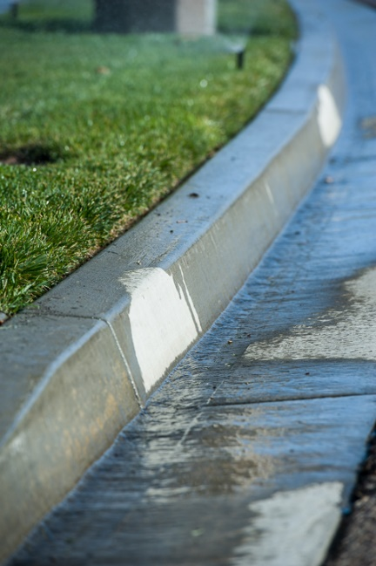
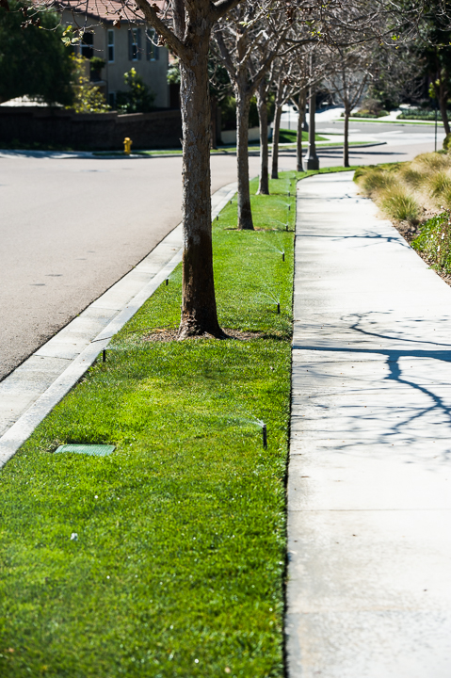
MP Side Strips vs Conventional Strip Sprays
VS.

Slide 32
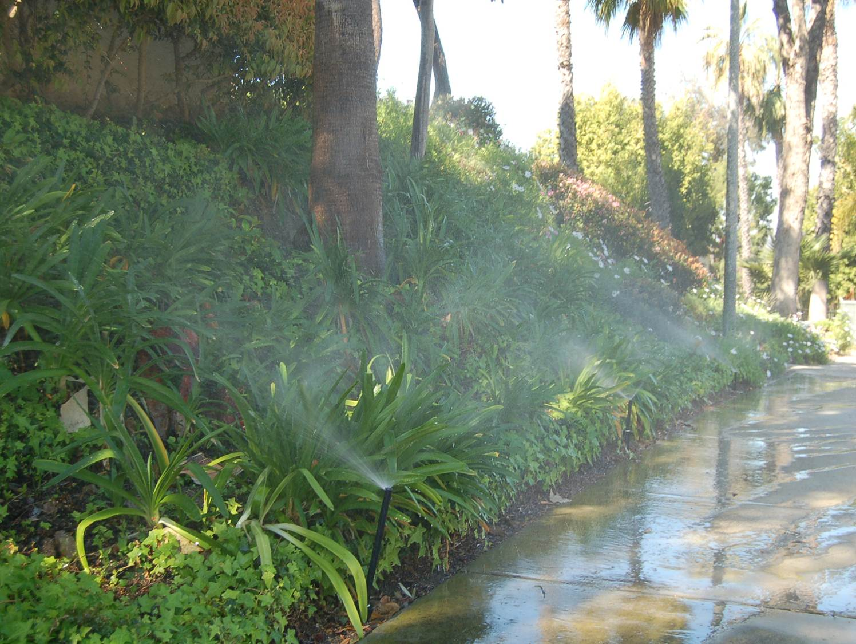
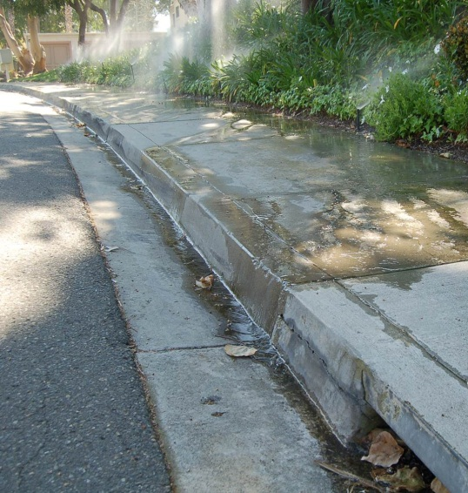
MP Rotators Eliminate Dry Season Run-off
Before
Notes:
This gives an idea of what employees are getting to remind us to be conscious of the environment.

Slide 33
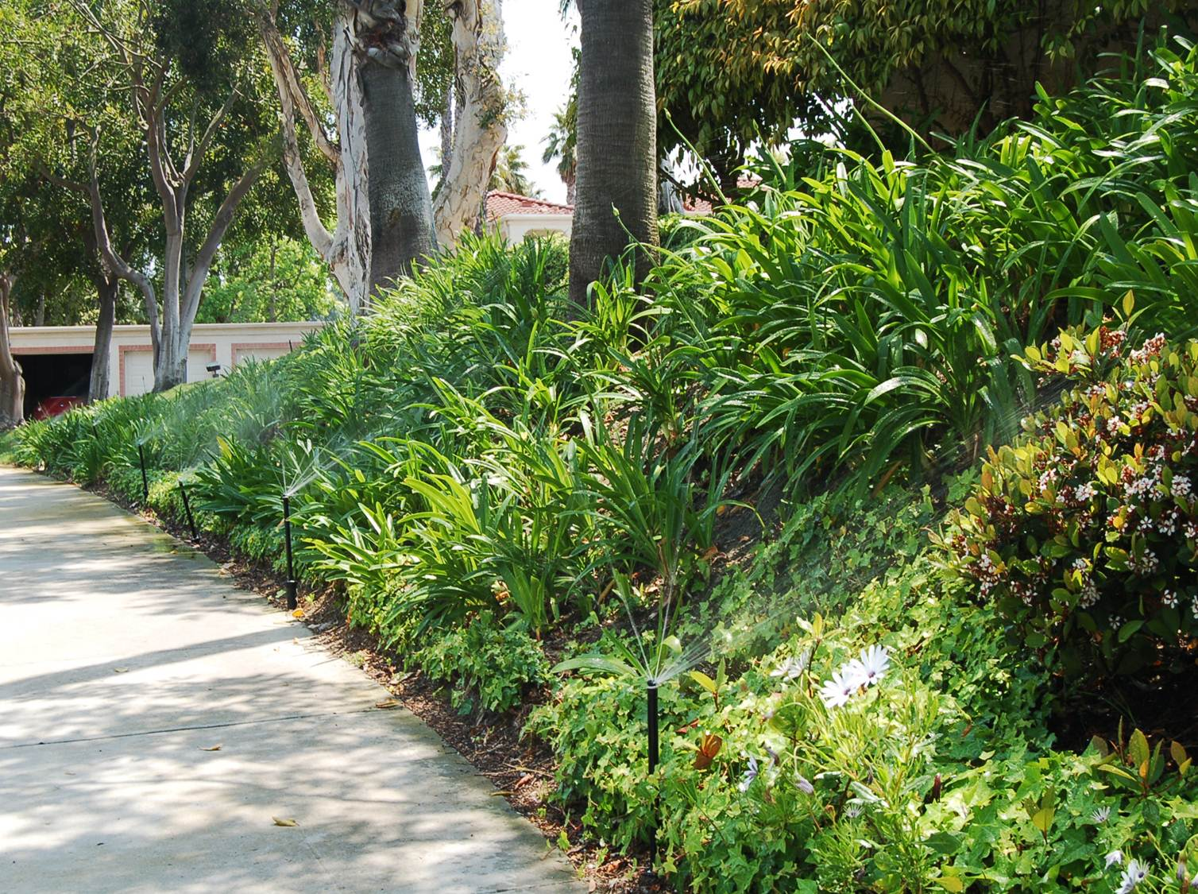
MP Rotators Eliminate Dry Season Run-off
After
Notes:
This gives an idea of what employees are getting to remind us to be conscious of the environment.

Slide 34
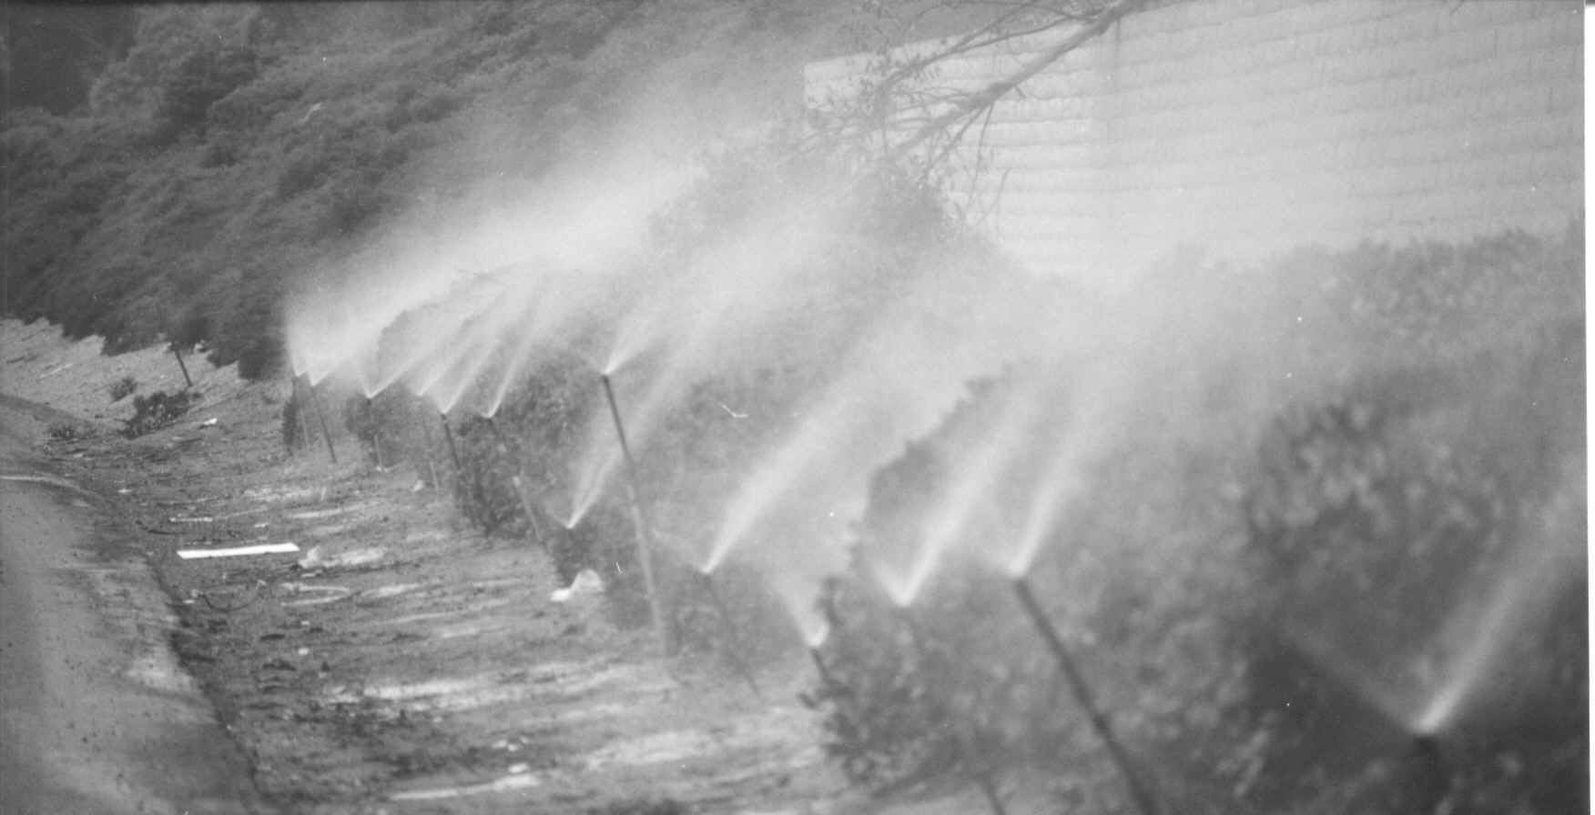
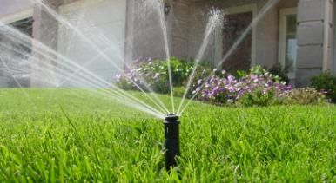
MP Rotator Advantage
Superior Wind Performance
50 PSI (3.5 Bar)
Misting
Wind drift
Runoff
50 PSI (3.5 Bar)
Wind-resistant
No misting
Rotating streams

Slide 35
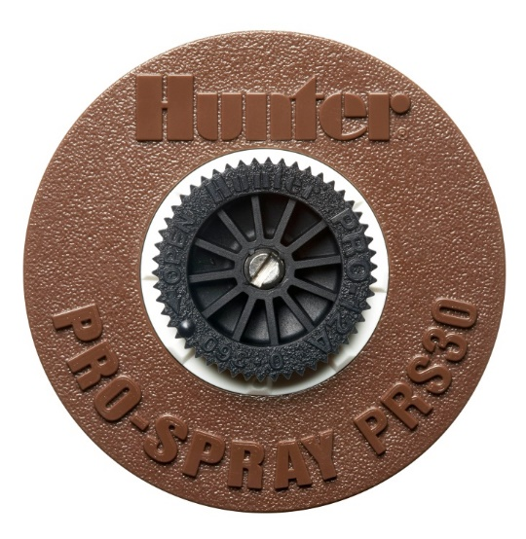
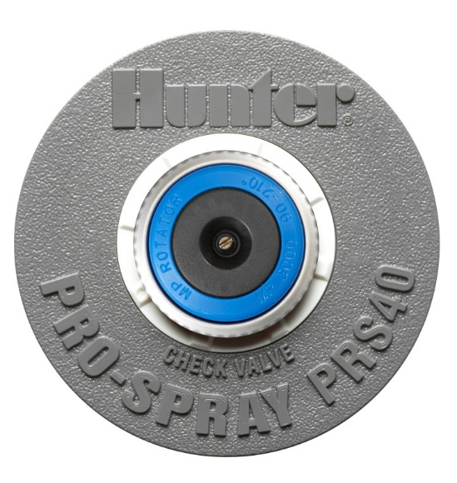
Ideal for Spray
Nozzle Retrofits
Fits on industry standard male thread pop-up
Works great with 30 or 40 PSI regulation
Use 30 PSI to achieve minimum radius
6’–9’ use with PRS-30
9’–35’ use with PRS-40

Slide 36

MP 800SR Optimal Performance

Slide 37

Pro-Spray PRS40
with MP Rotator
Shrub, 4", 6" and 12" models
Improves MP Rotator efficiency
Comes standard with pre-installed check valve
Pressure regulates at 40 PSI optimal for MP Rotators

Slide 38

MP Rotator
Advantages
Reliable by Design
One moving part
Multi-stream technology
Multiple trajectory streams
Patented double-pop feature for clog protection
Large water droplets
Low precipitation rate
25-year proven technology

Slide 39

PCB Bubblers
Pressure compensating
bubbler
Gallons per minute
.25 GPM – 2.0 GPM
Heaviest application rate
Short cycles
Riser install
Low traffic locations
Notes:
Pressure Compensating Bubblers are a decent option when conditions require a heavy application of water to soak an area. Commonly used for trees. Output measured in gallons per minute compared to drip which is gallons per hr. Riser installations only NOT ideal for high traffic areas.

Slide 40

MSBN Nozzles
Retracts flush with pop-up
Ideal in high traffic areas
Pressure compensating
Gallons per minute
0.25 GPM–2.0 GPM
Heaviest application rate
Short cycles
Directional quarter half and full patterns

Slide 41
MSBN / PCBN Retractable Bubbler Nozzles

Slide 42

MSBN Nozzles on popups
Robust point source solution
Use on 4” or 6” Pro Spray with
check valve
Lowest cost CV option
Military grade installation
Pops up to through ground cover to irrigate
Retracts flush when not in use
Specify as PROS-06-PRS30-CV/MSBN10H

Slide 43

Bubbler Systems

Slide 44
On Grade Drip

Slide 45
In-Line On-Grade
Drip Installation
Covered with 3” of mulch post installation.

Slide 46
On Grade Drip
Benefits:
  Easy to install
  Inexpensive to install
  Easy to repair
  Delivers water directly
  to roots
  No overspray
  Slower delivery of water
Issues:
  Requires more Maintenance
  Difficult to Schedule
  Can’t see it running /
  needs inspection
  Long term sustainability
  Damage from wildlife
  Requires Fertigation

Slide 47

Traditional Inline
Drip Wetting Pattern

Slide 48


Traditional Inline Drip Irrigation
Can Have High Application Rates
Emitter Flow Rate=1.0 GPH
Row Spacing | Emitter Spacing
 | 12” | 18” | 24”
12” | 1.60 | 1.07 | 0.80
14” | 1.38 | 0.92 | 0.69
16” | 1.20 | 0.80 | 0.60
18” | 1.07 | 0.71 | 0.53
20” | 0.96 | 0.64 | 0.48
24” | 0.80 | 0.53 | 0.40

Slide 49

Point Source Drip

Slide 50

Drip Emitters are Measured in GPH (Gallons per Hour)

Slide 51


SR Series Filtration
Recommend 100 mesh filtration for dirty water systems
60 mesh filter on MP800SR 90

Slide 52

Smart Control
PRESENTED BY: Chris Roesink CLIA, CID, CIC, CWCM, CLT-I

Slide 53

PRO-C Controller
Notes:
• New Design

Slide 54
Solar Sync
Built In

Slide 55
Solar Sync: Affordable, Simple Weather Based Control
Adjusts watering to changes in climate conditions
Most economical solution
for weather-based control
Simple to program and install
Reduces water usage and improves
plant health
Great for all installations and qualifies for many water conservation rebate programs!
Easily convert X-Core, Pro-C, ICC,
I-Core, and ACC to smart control

Slide 56

What is Smart
Control?
Controllers that estimate or measure depletion of available plant soil moisture in order to operate an irrigation system, replenishing water as needed while minimizing excess
water use
The EPA’s WaterSense protocol performance testing measures the water applied by properly installed and programmed smart controller without human intervention
Solar Sync has met the stringent WaterSense test guidelines and all Hunter AC powered controllers have been certified
For optimum results, it is important that systems utilize proper design, installation and maintenance

Slide 57

What is Smart
Control?
  Most controller schedules are not adjusted for seasonal watering requirements
  Significant water savings can be achieved by watering to ET

Slide 58

What is ET?
Evapotranspiration (ET)
The science of estimating how much moisture the plants and soil have lost due to weather conditions; used to calculate irrigation amounts
Atmospheric conditions act on plants & soil
Soil reservoir = moisture available to root zone
CIMIS illustration

Slide 59


Solar Sync Sensor Gathers On-Site Weather
  Sensor calculates ET based upon on-site solar and temperature measurements
  Rain-Clik and Freeze-Clik ensure system shutdown during rainy/freezing conditions

Slide 60

Solar Sync Automatic Daily Adjustment!
  Sensor calculates ET based upon
  on-site solar and temperature measurements
  Rain-Clik and Freeze-Clik ensure system shutdown during rainy/
  freezing conditions

Slide 61

Seasonal Adjustment
100% = Set Run Times for midsummer (peak demand time of year)
30 minutes
30 minutes
30 minutes
30 minutes
Zone 1
Zone 2
Zone 3
Zone 4
3:00 AM
4:00 AM
5:00 AM

Slide 62

Seasonal Adjustment
70% = Run Times adjusted for actual conditions
Savings
20 minutes
20 minutes
20 minutes
20 minutes
Zone 1
Zone 2
Zone 2
Zone 3
Zone 3
Zone 1
Zone 4
3:00 AM
4:00 AM
5:00 AM

Slide 63


Wireless Solar Sync
WSS – Module, Wireless Receiver, Wireless Sensor (for older Pro-C models and ICC)
WSS-SEN - Wireless Receiver, Wireless Sensor (for X-Core, new Pro-C/PCC, I-Core and ACC)
Wireless Sensor has 800 foot range
Wireless Receiver connects directly to the controller
Wireless Receiver can be mounted to controller in an available knock-out or to the wall using supplied bracket
Multiple Receivers can be operated from a single Sensor
Notes:
Solar Sync ET based weather sensor.
3 sensors in 1
Simple to program, easy to install.
Saves water
Qualifies as “Smart” Controller for California’s AB1881

Slide 64


Soil Moisture Sensors
Soil Clik Overview

Slide 65
Add Real Soil Measurement with Soil-Clik
Simple clik shutoff device
Prevents watering when
soil is wet enough
Works with any Hunter
controller via sensor input
Works with virtually
any AC powered controller,
as common interrupt
Indoor/Outdoor mounting

Slide 66

Soil-Clik Module
(Visual Moisture Indicator)
Soil-Clik Sensor

Slide 67

Module: Simple to Install
Low voltage device gets 24 VAC power from controller
Goes in, or next to, the host controller (6 ft/2 m max)
Connects to single pair of wire leads from Probe
Up to 1000 ft/300 m from Module to Probe
One Probe per Soil-Clik
6 ft/2 m, max
1000 ft/300 m, max

Slide 68

Why Soil Moisture?
Gives an exact reading of a key spot in the landscape
Eliminates guesswork
Makes controllers “smarter”
Saves water

Slide 69

Total Environmental Awareness: Soil-Clik + Solar Sync
Solar Sync makes intelligent adjustments to application amounts, but
Solar Sync does not adjust day schedules
Solar Sync doesn’t measure rainfall
Soil-Clik knows whether the driest spot in the landscape is wet, or not.
Soil-Clik measures how wet the soil is
Soil-Clik won’t allow watering
on days that don’t need it
Soil-Clik won’t allow watering
on wet turf
Use them together!
Total Environmental Awareness

Slide 70


Hunter
Flow-Sync
Track water use and stop breaks in their tracks

Slide 71

Thank You
Soil Clik Overview

